Slide 1
EXECUTIVE SUMMARY REPORT ON
SALES DATASET
Oluwasola Arigbabowo
December 2020

Slide 2
BUSINESS GOAL
Leverage Vana360 e-commerce dataset to perform an exploratory data analysis by developing an interactive analytics dashboard which shows the trends, patterns and key points of interest from the store's historic data.
What are your recommendations to help Vana360 make informed decisions on how to improve sales?

Slide 3
DATA SOURCE
& TOOLS
The source for the database for the analysis is
Postgres SQL Server – Datatechon
The data analytics tool used are:
Excel
Power BI

Slide 4
KEY METRICS & DIMENSIONS
METRICS
Total Sales
Total Profits
Total COG (Cost of Production)
Total Units Sold
Total Customers
Total Products
DIMENSION
Product- type, category and segment
Campaign- device and traffic channel
Location- region, location and state

Slide 5
METHODOLOGY
Import dataset via excel integrated in Power BI
Source = Excel.Workbook(File.Contents("C:\Users\okari\D ownloads\Vana360.xlsx"), null, true)

Slide 6
METHODOLOGY
Modelling data using unique key to join existing tables in Power BI
Data cleaning and transformation using Excel & Power BI
Sort rows in Ascending order and transform
Split columns by delimeter
= Table.DuplicateColumn(#"Renamed Columns", "Location", "Location - Copy")
Reorder columns
= Table.ReorderColumns(#"Duplicated Column",{"Zip", "Location", "Location - Copy", "State", "Region", "District", "Country"})
Filter values - to remove bank values

Slide 7
METHODOLOGY
Data exploration by developing an interactive dashboard to identify key insights using Power BI
Sales view
Product view
Customer view
Campaign view
Regional view
Sales forecasting view
Generate key insights from data exploration
Recommendation on sales, customer and campaign insights to best drive sales.

Slide 8
DATA EXPLORATION

Slide 9
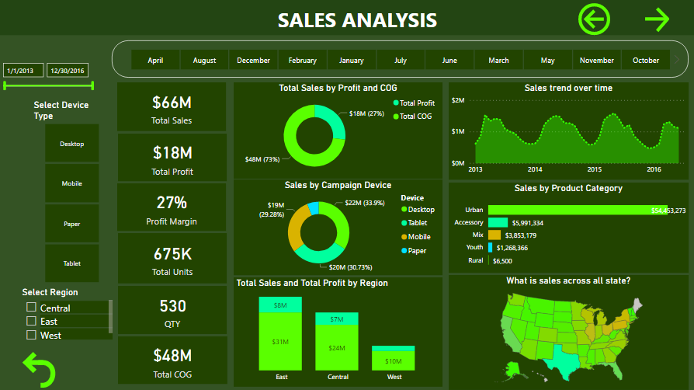

Slide 10
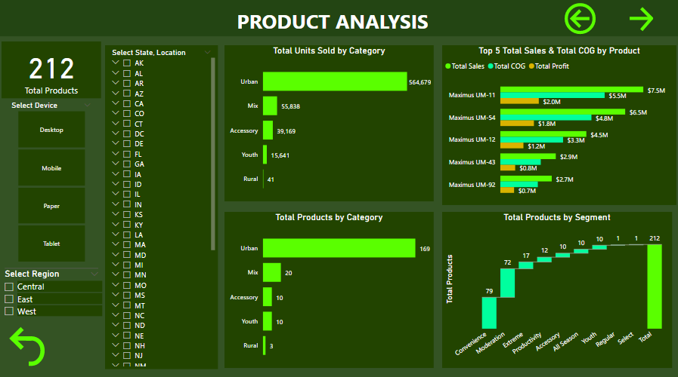

Slide 11
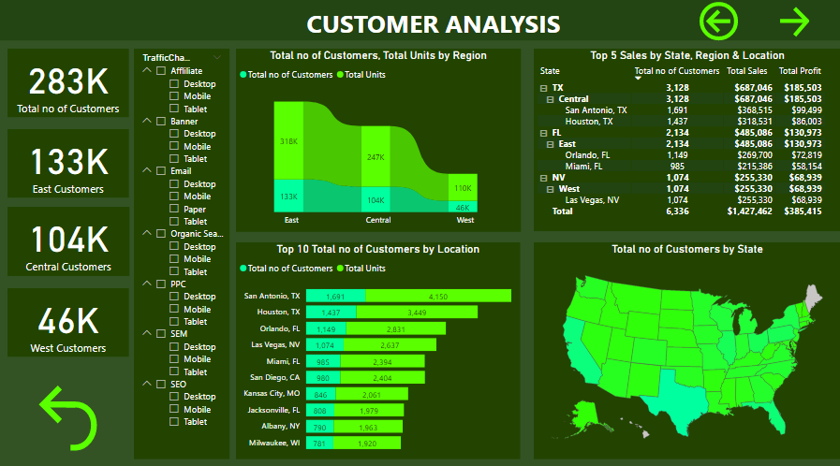

Slide 12
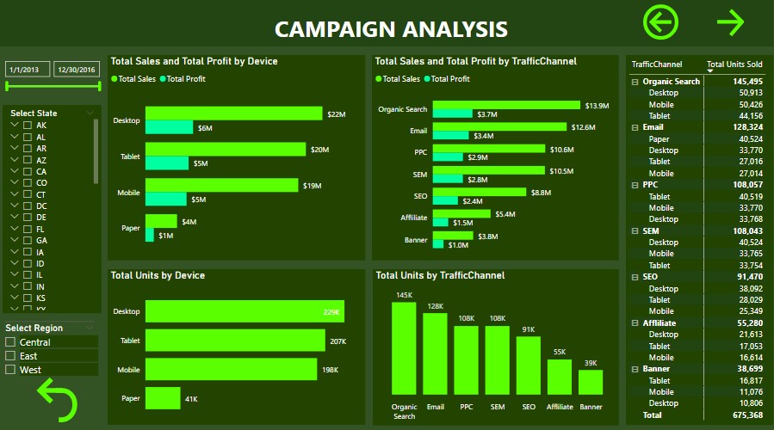

Slide 13
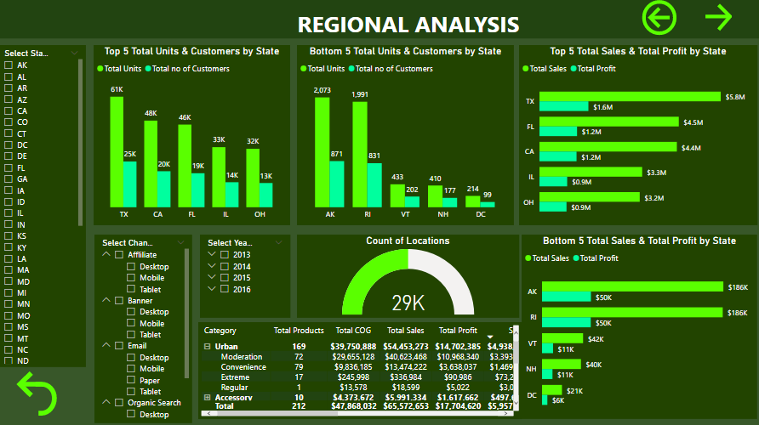

Slide 14
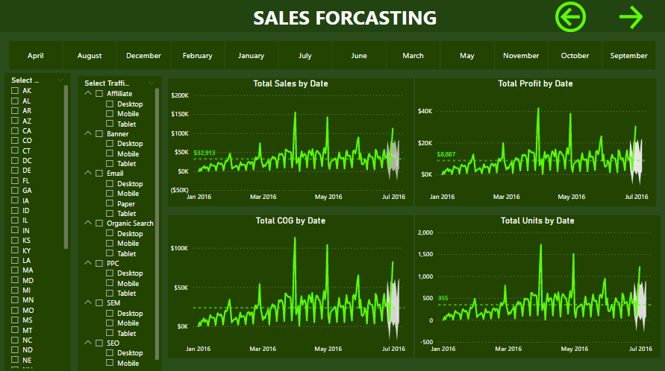

Slide 15
KEY INSIGHTS

Slide 16
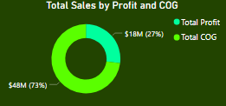
SALES
The cost associated with production is 73% of the total revenue and the profit margin of the business is 27%
A larger percentage of the total sales are attributed to the COG
Viable product branding and effective marketing strategy should be employed to drive up the unit sold to increase profit margin

Slide 17
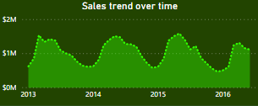
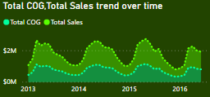
TREND
Sales trend over time shows a consistent dip at the beginning of Q4 and an increasing trend in Q1
Peak sales period occurs in Q2 and early Q3
Total sales peaks at an average of 1.5M, and experiences about 44% dip in sales from the late of Q3 to end of Q4.
Q4 appears as an opportunity area to boost seasonal sales.
Total Sales and COG seems to follow the same trend i.e., the COG increases when the total sales increase
Measures should be put in place to reduce COG where total sales increases to maximize profitability

Slide 18
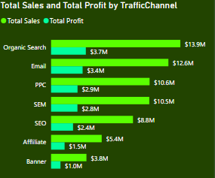
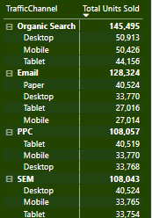
TRAFFIC
CHANNEL
Organic search campaign channel account for 21% of the total revenue
Organic search appears most viable in generating highest units sold
Organic search and emails were the highest contributors to unit sold and it could be inferred that the products have limited presence in physical advertisement medium such as banners and papers

Slide 19
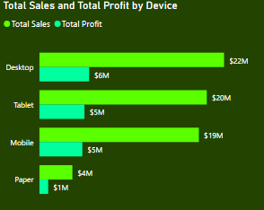
DEVICE
Campaign via desktop ranked highest with 33% of the total revenue generated
Many of the customers used desktop. It could be observed that across the device used in traffic channels, desktop seems to account for more unit sold than the mobile.
Use of more accessible and portable devices like mobile and tablets would generate more unit sold and an increase the total sales

Slide 20
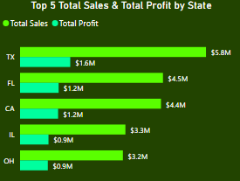
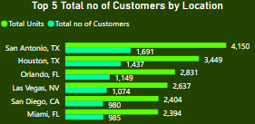
LOCATION
Texas ranked highest where customers are located and generated the highest revenue by state
Texas seems to be the biggest consumer of the products given that the total units sold in Texas alone is nearly 50% of the top 5 total units.
It could be estimated that 2.43 units were sold per customer on the average. This appears to be similar rate across the top 5 locations.

Slide 21
RECOMMENDATION
The sales trend insight shows a dip at the start of Q4 with sales remaining low till early Q1, this could be as a result of winter season setting in, however, there could be a window of opportunity in the festive season to capitalize on the gifting culture, promoting products that can be used as gift items to cash in on the high spending culture of the holidays
The cost of production should be reduced or maintained so as to capitalize on peak sales season to boost the total revenue. This will in turn increase the profit margin and makes the business more sustainable.
Based on the campaign insights, it could be observed that mobile is not the leading device used by customers. Given that this is an era where people spend more time on their phone than other device, this could be an area of opportunity for the business to ensure that their site are mobile friendly and can be assessed easily. Also, mobile app options can also be explored
The population of Texas should be leveraged to increase sales since the highest two location of consumers are in Texas. Also, Increasing total unit per customer by introducing some multi-item promo that could encourage customers to purchase more products

